Slide 1

Healthcare Analytic Project
Ishani Anil Zoting
Saloni Prabhakar Thakur
PRADEEP PANDEY
Sunil Gupta
Chaitanya Vinod Wankhede
Dilip K
Stephen Sam .M

Slide 2
AGENDA
1
Total Discharge
7
QTD
13
Powerbi Dashboard
2
Patient Days
8
YTD
14
Tableau Dashboard
3
Net Patient Revenue
9
Total Patient/ Hospital
15
Challenges how we over come
4
Revenue Trend
10
Recommendation’s for improvement
5
State Hospital Revenue
11
Excel Dashboard
6
Types Of Hospital Revenue
12
SQL Queries

Slide 3
TOTAL DISCHARGE
TOTAL DISCHARGE
1
OBJECTIVE:
To measure the hospital's patient throughput over a five-year period (2016-2020).
2
IMPORTANCE:
Tracking the total number of discharges can indicate the
hospital’s capacity utilization, efficiency in patient care,
and overall operational performance.

Slide 4
PATIENT DAYS
TOTAL DISCHARGE
1
OBJECTIVE:
To monitor the total number of patient days, reflecting the duration of care
provided within the hospital over a five-year period (2016-2020).
2
IMPORTANCE:
Patient Days is a crucial indicator of hospital utilization, resource allocation,
and the average length of stay for patients.

Slide 5
NET PATIENT REVENUE
TOTAL DISCHARGE
1
OBJECTIVE:
To track the revenue generated from patient services over the five-year period (2016-2020).
2
IMPORTANCE:
Net Patient Revenue reflects the hospital's financial health, directly tied to
patient care services and billing efficiency
3
YEARLY REVENUE:
Compare net patient revenue
annually to assess
financial growth or decline.

Slide 6
REVENUE TREND
TOTAL DISCHARGE
1
OBJECTIVE:
To analyze the overall trend in
hospital revenue over the five-year
period (2016-2020).
2
IMPORTANCE:
Monitoring revenue trends is essential for
understanding the financial trajectory
of the hospital and planning for
future growth.
3
Trend Analysis:
Identify patterns in revenue
growth, stability, or decline over
the years (2016-2020).

Slide 7
STATE HOSPITAL REVENUE
TOTAL DISCHARGE
1
OBJECTIVE:
To monitor the revenue generated by the hospital within the state context over five years (2016-2020).
2
IMPORTANCE:
Understanding state-specific revenue helps in assessing the hospital's competitive position
and financial health within its regional market.
3
YEARLY REVENUE BY STATE:
Track revenue trends specifically within the state to identify growth or decline.

Slide 8
TYPES OF HOSPITAL REVENUE
TOTAL DISCHARGE
1
OBJECTIVE:
To analyze the different sources of revenue for the hospital over the five-year period.
2
IMPORTANCE:
Understanding the composition of hospital revenue by type helps in identifying which
services or departments are most profitable

Slide 9
QTD/YTD Revenue
TOTAL DISCHARGE
1
OBJECTIVE:
To monitor Quarter-to-Date (QTD) and Year-to-Date (YTD) revenue, providing timely insights
into financial performance within shorter and longer timeframes.
2
IMPORTANCE:
QTD and YTD revenue figures are crucial for understanding the hospital’s financial performance
relative to targets and historical performance.

Slide 10


Total Patient / Total Hospital
TOTAL DISCHARGE
1
OBJECTIVE:
To assess the ratio of total patients treated to the hospital's overall capacity and operations over the five-year period.
2
IMPORTANCE:
This metric reflects the hospital’s efficiency in handling patient volume relative to its overall operational capacity.

Slide 11
RECOMMENDATIONS
TOTAL DISCHARGE
1
Strategic Investments:
Invest in high-growth areas identified in the trend analysis to boost future revenue.
2
Regional Marketing:
Enhance marketing efforts in underperforming areas within the state to capture more market share.
3
Improve outpatient facilities:
Ensure that outpatient facilities are comfortable, efficient, and equipped with modern technology.

Slide 12
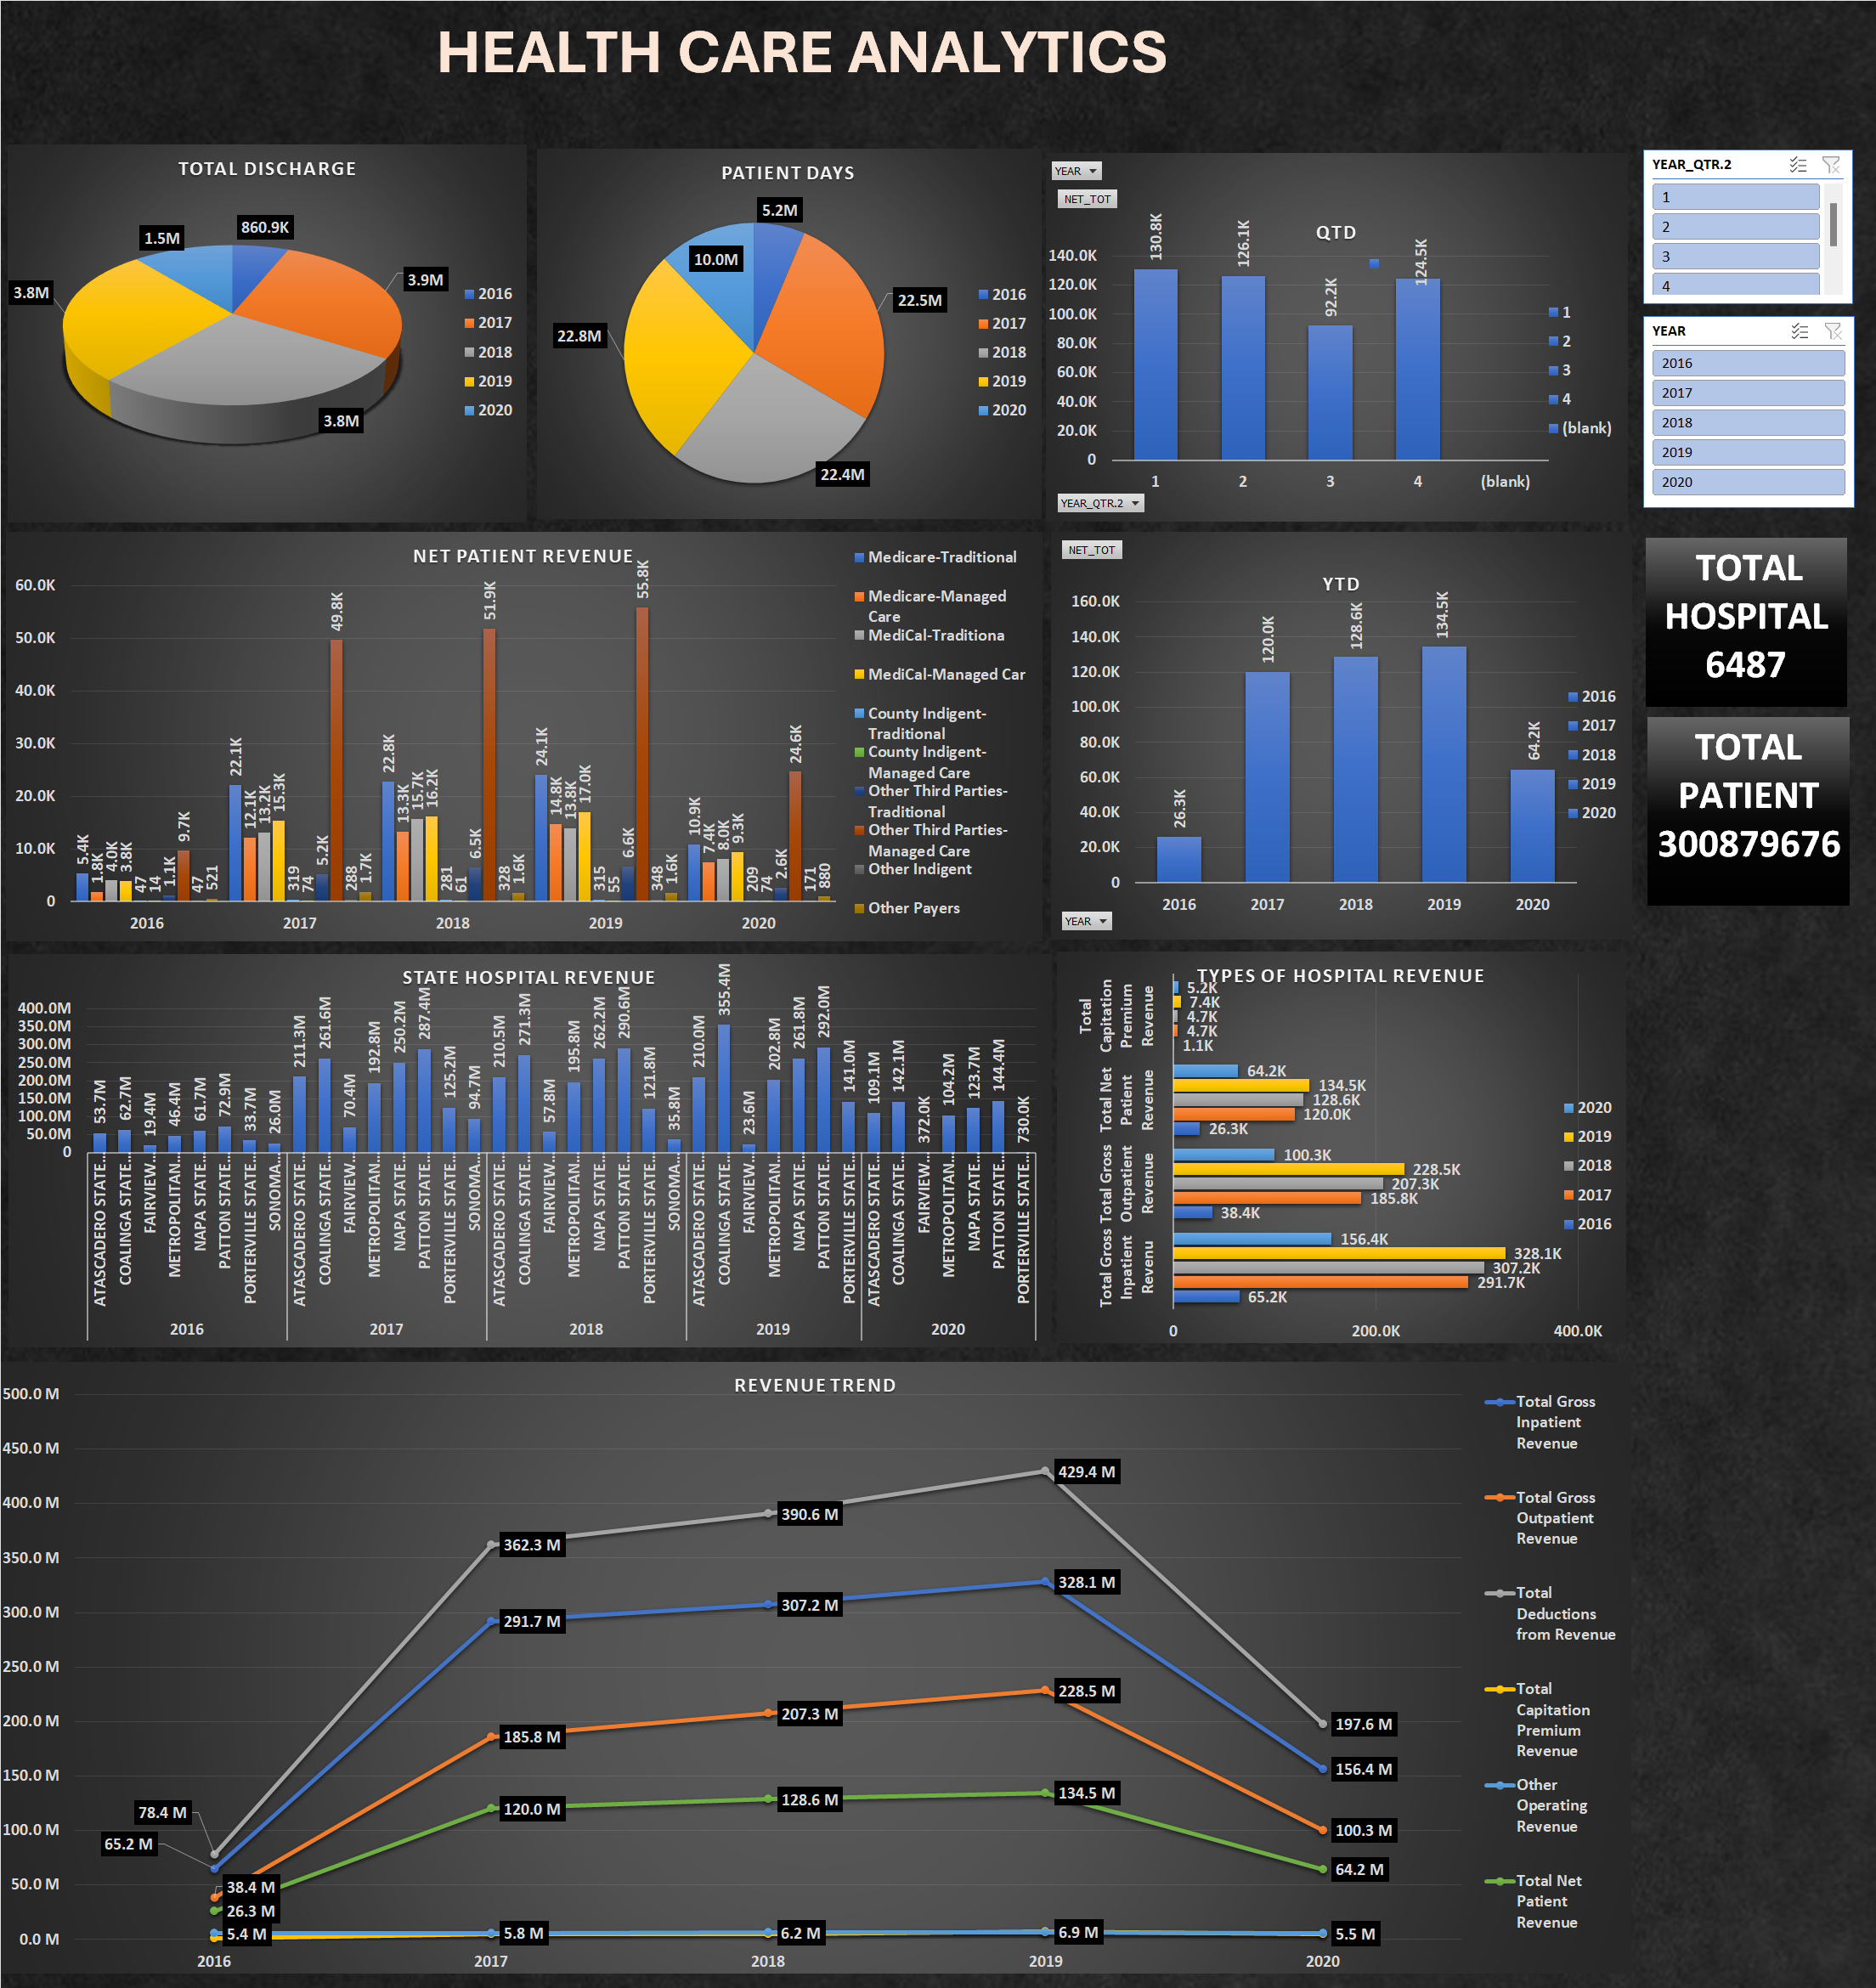
Excel Dashboard

Slide 13
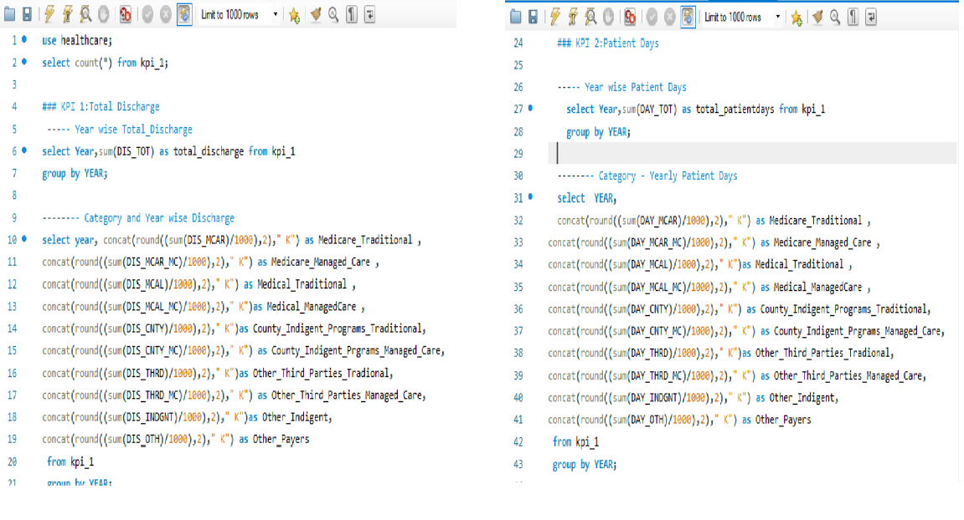
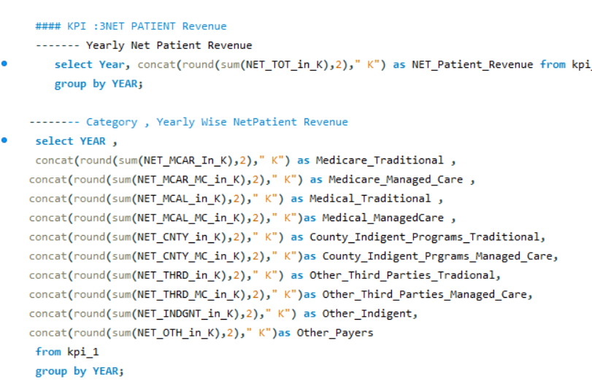
SQL QUERIES

Slide 14
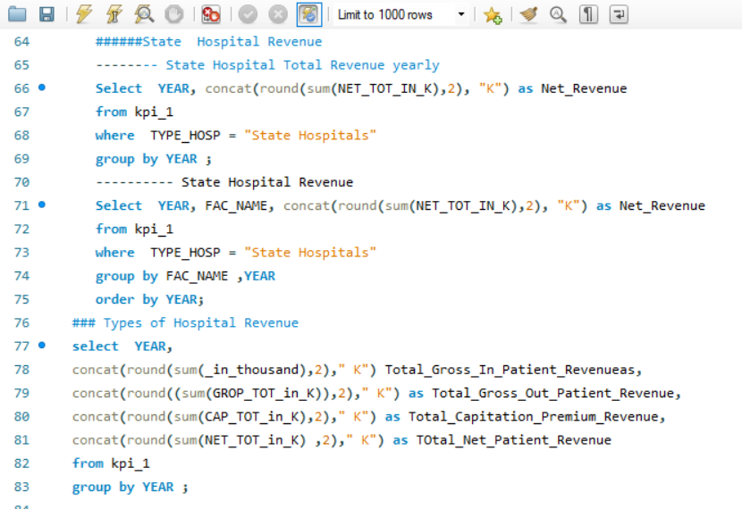
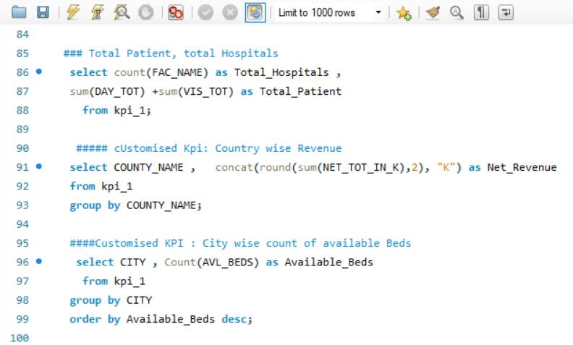
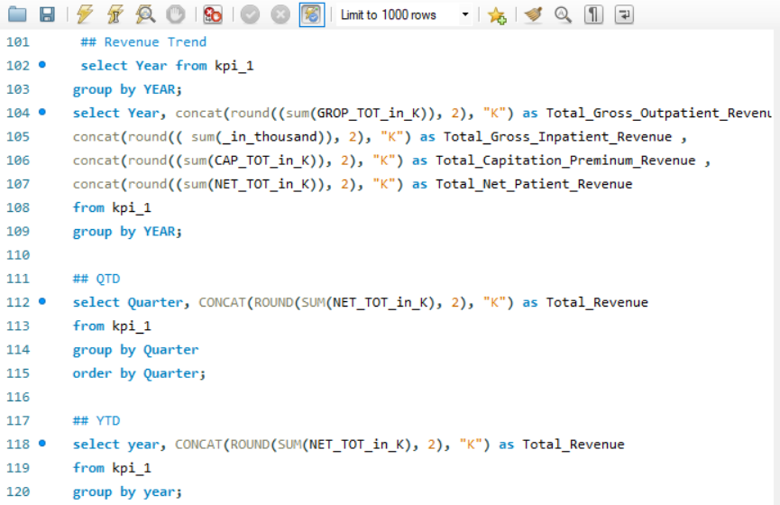
SQL QUERIES

Slide 15
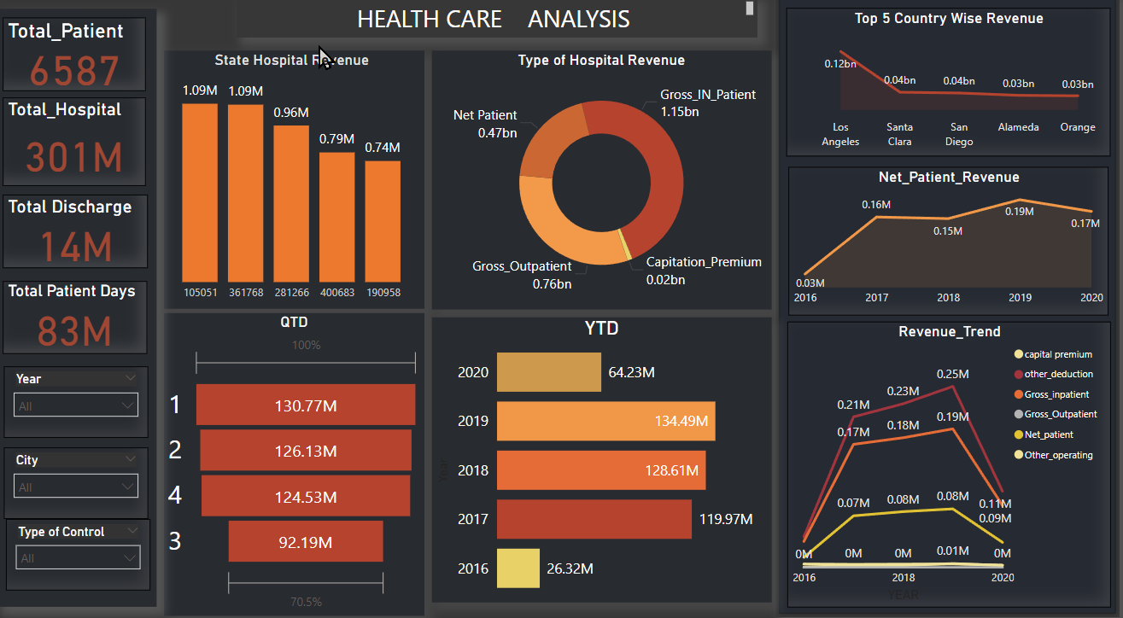
Power BI Dashboard

Slide 16
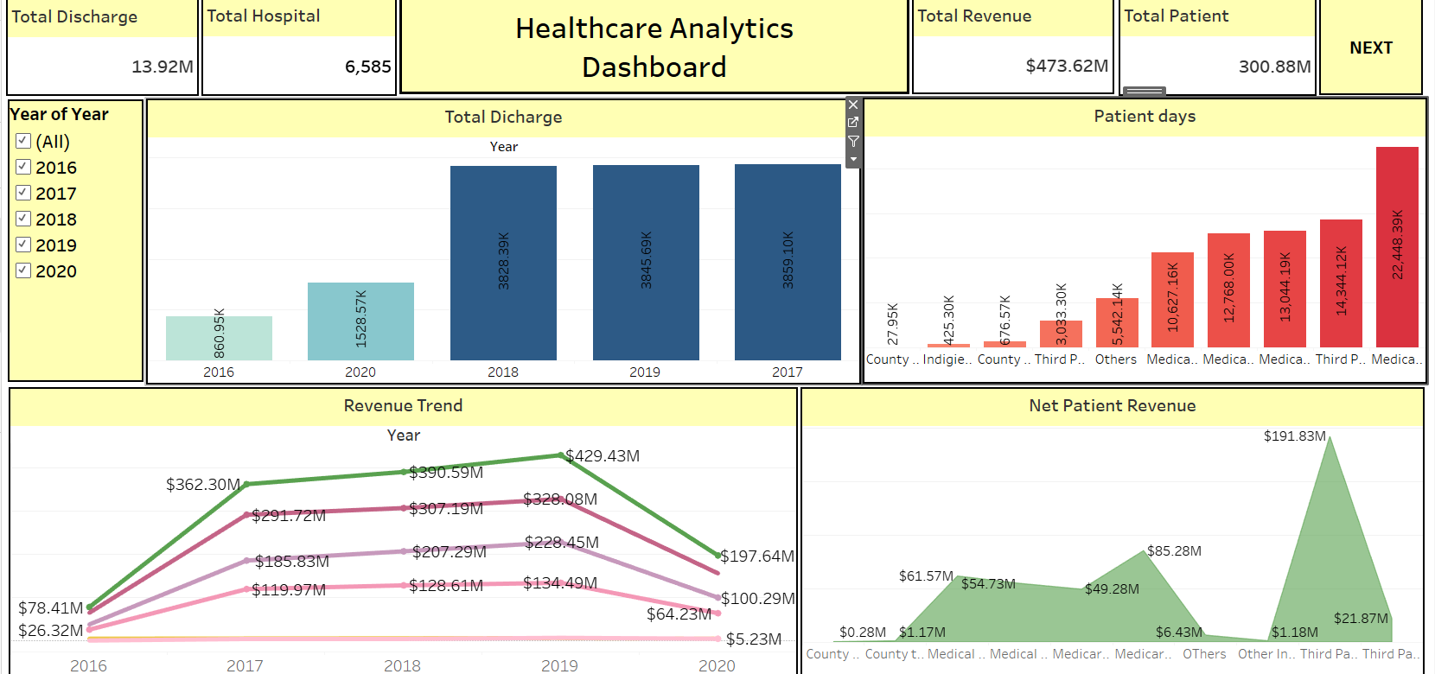
Tableau Dashboard

Slide 17
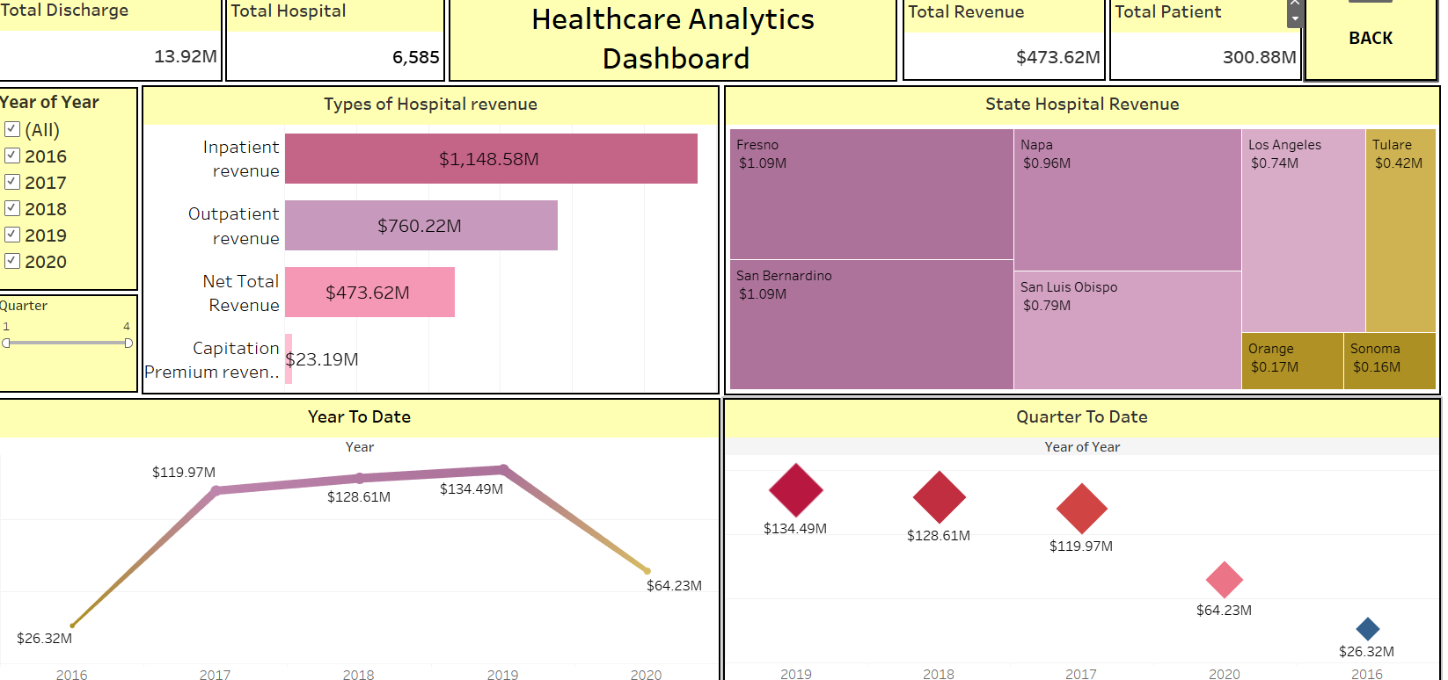
Tableau Dashboard 2

Slide 18


.
CHALLENGES HOW WE OVERCOME
1
DATA CLEANING & TRANSFORMATION
The date column needed splitting into year and quarter, followed by merging data year-wise and appending all years into a single file. This was a complex task.
How We Overcame: We used Excel to split, merge, and validate the data, ensuring accuracy and preventing data loss.
2
SQL DATA IMPORT
Importing the Excel file into MySQL Workbench led to multiple errors.
How We Overcame: We used Power Query to clean and transform the data, allowing a smooth import into MySQL Workbench.

Slide 19

Thank You

